Slide 1
Branding for Buy-in
Branding your General Education Competencies for Faculty Buy-in

Slide 2
Introductions
Holly Norton, Vice President of Educational and Student Services
Shelli Stuart, Math Faculty and Assessment Chair
Lisa Dennis, Director of Academic Support

Slide 3
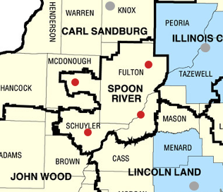
About Spoon River College
Small, rural community college in West Central Illinois
Four locations
Canton – Main campus
Macomb – Second campus
Havana Center
Rushville Center
Fall 2023 Enrollment – 1,097
Fall 2023 FTE – 664
Notes:
All four locations are 40-45 minutes apart

Slide 4
SRC’s General Education Competencies
Communicate effectively to achieve individual and organizational goals.
Use critical, mathematical, and scientific methods to solve problems.
Utilize principles of equity to make responsible choices in a diverse world.
Exhibit human empathy through appreciation of arts and creativity.
Obtain and use information to make sound decisions.
Work collaboratively with others to solve problems and achieve common goals.
Notes:
Lots of confusion in general… over the numbers for GECs, over the process of assessment, etc. We really needed to make it easier for faculty to digest in order to increase participation in the overall assessment process.

Slide 5
Assessment Cycle Before Branding
A student earning a degree from Spoon River College will be able to:
Communicate effectively to achieve individual and organizational goals.
Use critical, mathematical, and scientific methods to solve problems.
Utilize principles of equity to make responsible choices in a diverse world.
Exhibit human empathy through appreciation of arts and creativity.
Obtain and use information to make sound decisions.
Work collaboratively with others to solve problems and achieve common goals.
The GECs will be assessed on a rotating three-year schedule:
Year 1: GECs 1 & 2 (2017-2018)
Year 2: GECs 3 & 4 (2018-2019)
Year 3: GECs 5 & 6 (2019-2020)
Notes:
The previous process allowed for faculty to choose from two different GEC’s per year on a 3-year cycle in order to assess all 6 GEC’s. While choice can sometimes promote buy-in; in this case, it was keeping us from collecting consistent data. We used a Canvas course for faculty to submit assessment reports, but only participating faculty were enrolled in the course.

Slide 6
ICCCA 2019
Attended session called, “Brand Your Objectives” presented by the two Co-Directors of the Nursing Assistant program at ICC.
Why is branding powerful?
Easier recall
Instructor buy-in
Branding brings consistency
Influences the way people talk and reference content
Notes:
Attended a presentation by folks from ICC regarding branding of their Nursing Assistant program.
We left the session wondering if the concepts they covered could be applied to our assessment process. All of these reasons for branding being powerful were issues we were experiencing in the assessment process.

Slide 7
Notes:
At ICC - used the logo on marketing materials, but also in PowerPoint in the corner of each slide. Depending on the content being addressed, one of the three was highlighted and the other two were grayed out in order to give students clarity on how the information was tied to that specific program objective.

Slide 8
The Branding Process

Slide 9
Labels for our GECs
Communicate effectively to achieve individual and organizational goals. COMMUNICATION
Use critical, mathematical, and scientific methods to solve problems. PROBLEM-SOLVING
Utilize principles of equity to make responsible choices in a diverse world. EQUITY
Exhibit human empathy through appreciation of arts and creativity. CREATIVITY
Obtain and use information to make sound decisions. DECISION-MAKING
Work collaboratively with others to solve problems and achieve common goals. COLLABORATION
Notes:
Our first step was to create labels for each GEC to reduce it to one word that was easier to remember and also encompassed the goal of the competency. This was not a super easy task, but it was beneficial in that it helped us think through what we really intended the goal to be for each GEC. In turn, prompted some revision (which is a good thing).

Slide 10
GEC Logo
Notes:
Consistent with our college branding – Snappers (snapping turtles)
Logo represents turtle shell; lots of hexagons on our marketing materials

Slide 11
GEC Poster
Notes:
Posters were printed and provided to faculty to put up in their office on the wall or bulletin board as a reminder; prompts them to think about assessment and continuous improvement.

Slide 12
GEC T-shirts (front)
Notes:
Old GEC labels before updating to current list.

Slide 13
GEC T-shirts (back)
2021-2022
COMMUNICATION: Communicate effectively to achieve individual and organizational goals.
PROBLEM-SOLVING: Use critical, mathematical, and scientific methods to solve problems.
2022-2023
EQUITY: Utilize principles of equity to make responsible choices in a diverse world.
CREATIVITY: Exhibit human empathy through appreciation of arts and creativity.
2023-2024
DECISION-MAKING: Obtain and use information to make sound decisions.
COLLABORATION: Work collaboratively with others to solve problems and achieve common goals.
Notes:
Concept was suggested by a committee member to have the back of the shirt similar to a concert T-shirt: Display each GEC with the semester or academic year that it is being assessed.
Provided to faculty at Professional Development in the fall of 2021 as a way of kicking off our updated assessment process.

Slide 14
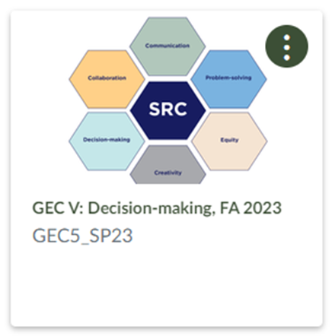
Branding helped simplify
An indirect result of the branding process was to simplify the assessment process overall.
Our Assessment Committee Chair recommended changing the assessment cycle to one GEC per semester, rather than per year. Everyone assesses the same GEC in order to provide consistent data.
A Canvas course is now created each semester and ALL faculty are enrolled as an expectation.
Notes:
A Canvas course had been used for several years as a resource and place for faculty to submit assessment reports, but they were enrolled on a voluntary basis.

Slide 15
Using Canvas Outcomes

Slide 16
Canvas Outcomes – Fall 2022
Struggled to incorporate this step into the process
HLC feedback facilitated need for Outcomes as a way to track institutional data
Held trainings; created videos; constant reminders
Notes:
This was something that was discussed off an on for a few years in the Assessment Committee, but never go traction. We came to the conclusion that it couldn’t be pushed because if some faculty were still struggling with assessment in general – what it is and why we do it – they truly can’t visualize how Outcomes would work. However, due to HLC feedback, we needed to move forward with Outcomes. Thankfully, we had a few years of the new assessment process before adding this step. The timing actually worked out.

Slide 17
Canvas Outcomes – progress
Participation has increased! ☺
One-word GEC label is also entered as the “friendly description” for the Outcome in Canvas.
This allows faculty to see the full description of the GEC along with the branding “label” we use to identify it.
Notes:
Seeing “friendly description” for the GEC Outcome in Canvas reinforces “branded” term or label.

Slide 18
Assessment Process Overview

Slide 19
Our process
We encourage faculty to start planning at the beginning of the semester to decide which assignment they plan to assess.
This also encourages faculty to set up their Canvas rubrics appropriately so that the identified GEC has been added to the rubric for assessment.
Faculty can then use the Learning Mastery Gradebook to refer to the assessment results when writing their assessment report.
Notes:
Given that some GEC’s are easier to assess in some disciplines vs. others, it’s a good idea to decide early so you can think about how you’re tying the results to the specific GEC.

Slide 20
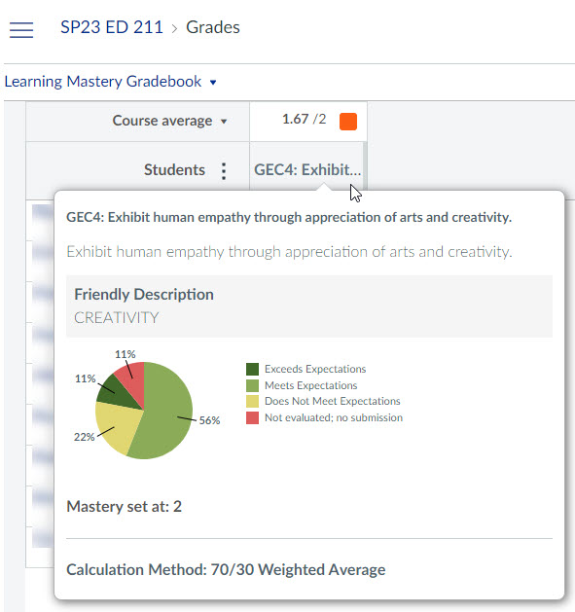
Learning Mastery Gradebook
Notes:
Example of a Learning Mastery Gradebook view; once faculty have assessed using the rubric, the data appears here for the faculty member to review.

Slide 21
Our process – instructional benefit
Creation of assignments that pertain to the specific GEC being assessed that semester
In turn, creates opportunities for students to demonstrate the GECs within the classroom

Slide 22
Our process (continued)
We pull the Canvas Outcomes report at the end of the semester and send to IR to merge with demographic data.
Once IR creates a summarized report, the Assessment Chair reports back to faculty at Professional Development Day.
Division Chairs hold meetings to discuss data.
Depending on results discussed, specific discipline meetings are held.

Slide 23
Creativity in Math
MAT 125 – College Algebra
Choose your three favorite parent functions. Use these functions and their transformations at least 3 times each to create a picture that has either x-axis, y-axis, or origin symmetry. Use various colors also creating symmetry.
Create a picture that does not have symmetry using at least 3 parent functions, with at least one different than the three from above, and their transformations that is pleasing to the eye. Use at least 10 functions. Color is expected.
MAT 126 – Plane Trigonometry
Graphs of polar equations
Notes:
Did we have some faculty push back on not wanting to assess a particular GEC due to their discipline? A little, but not a large percentage. Here’s a math assignment that demonstrates creativity…

Slide 24
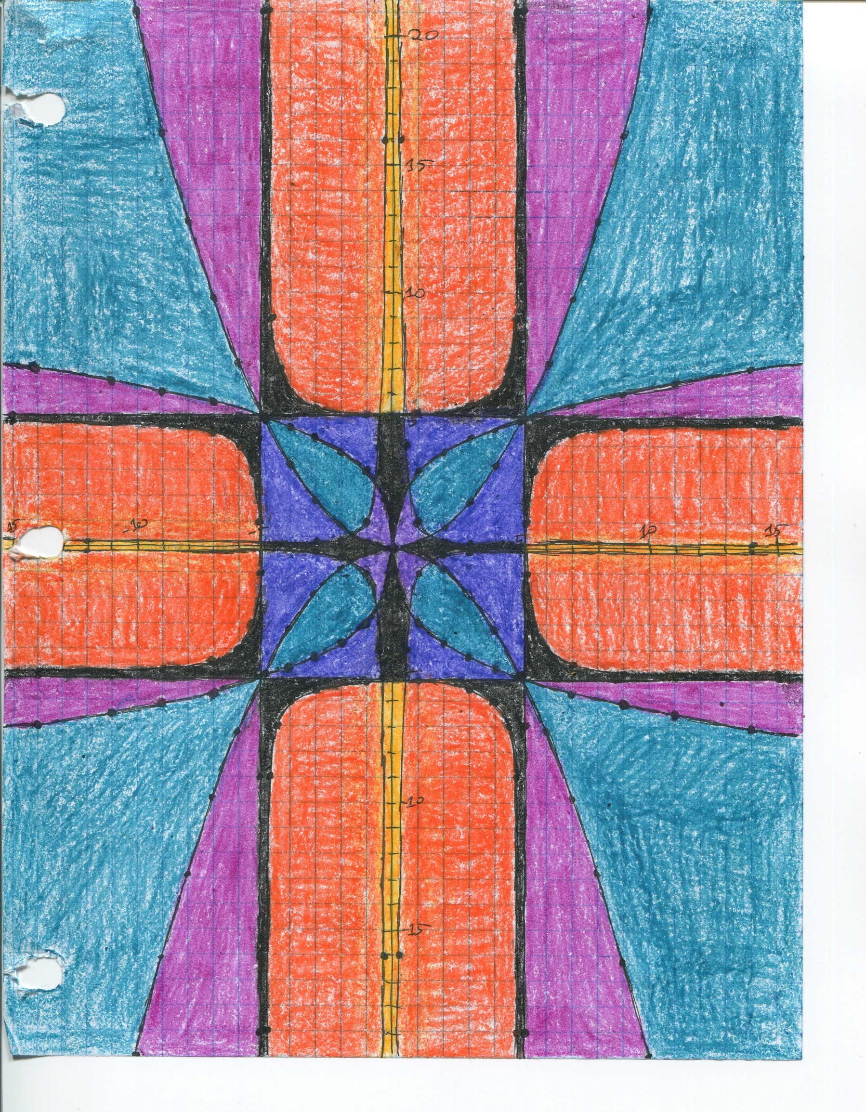
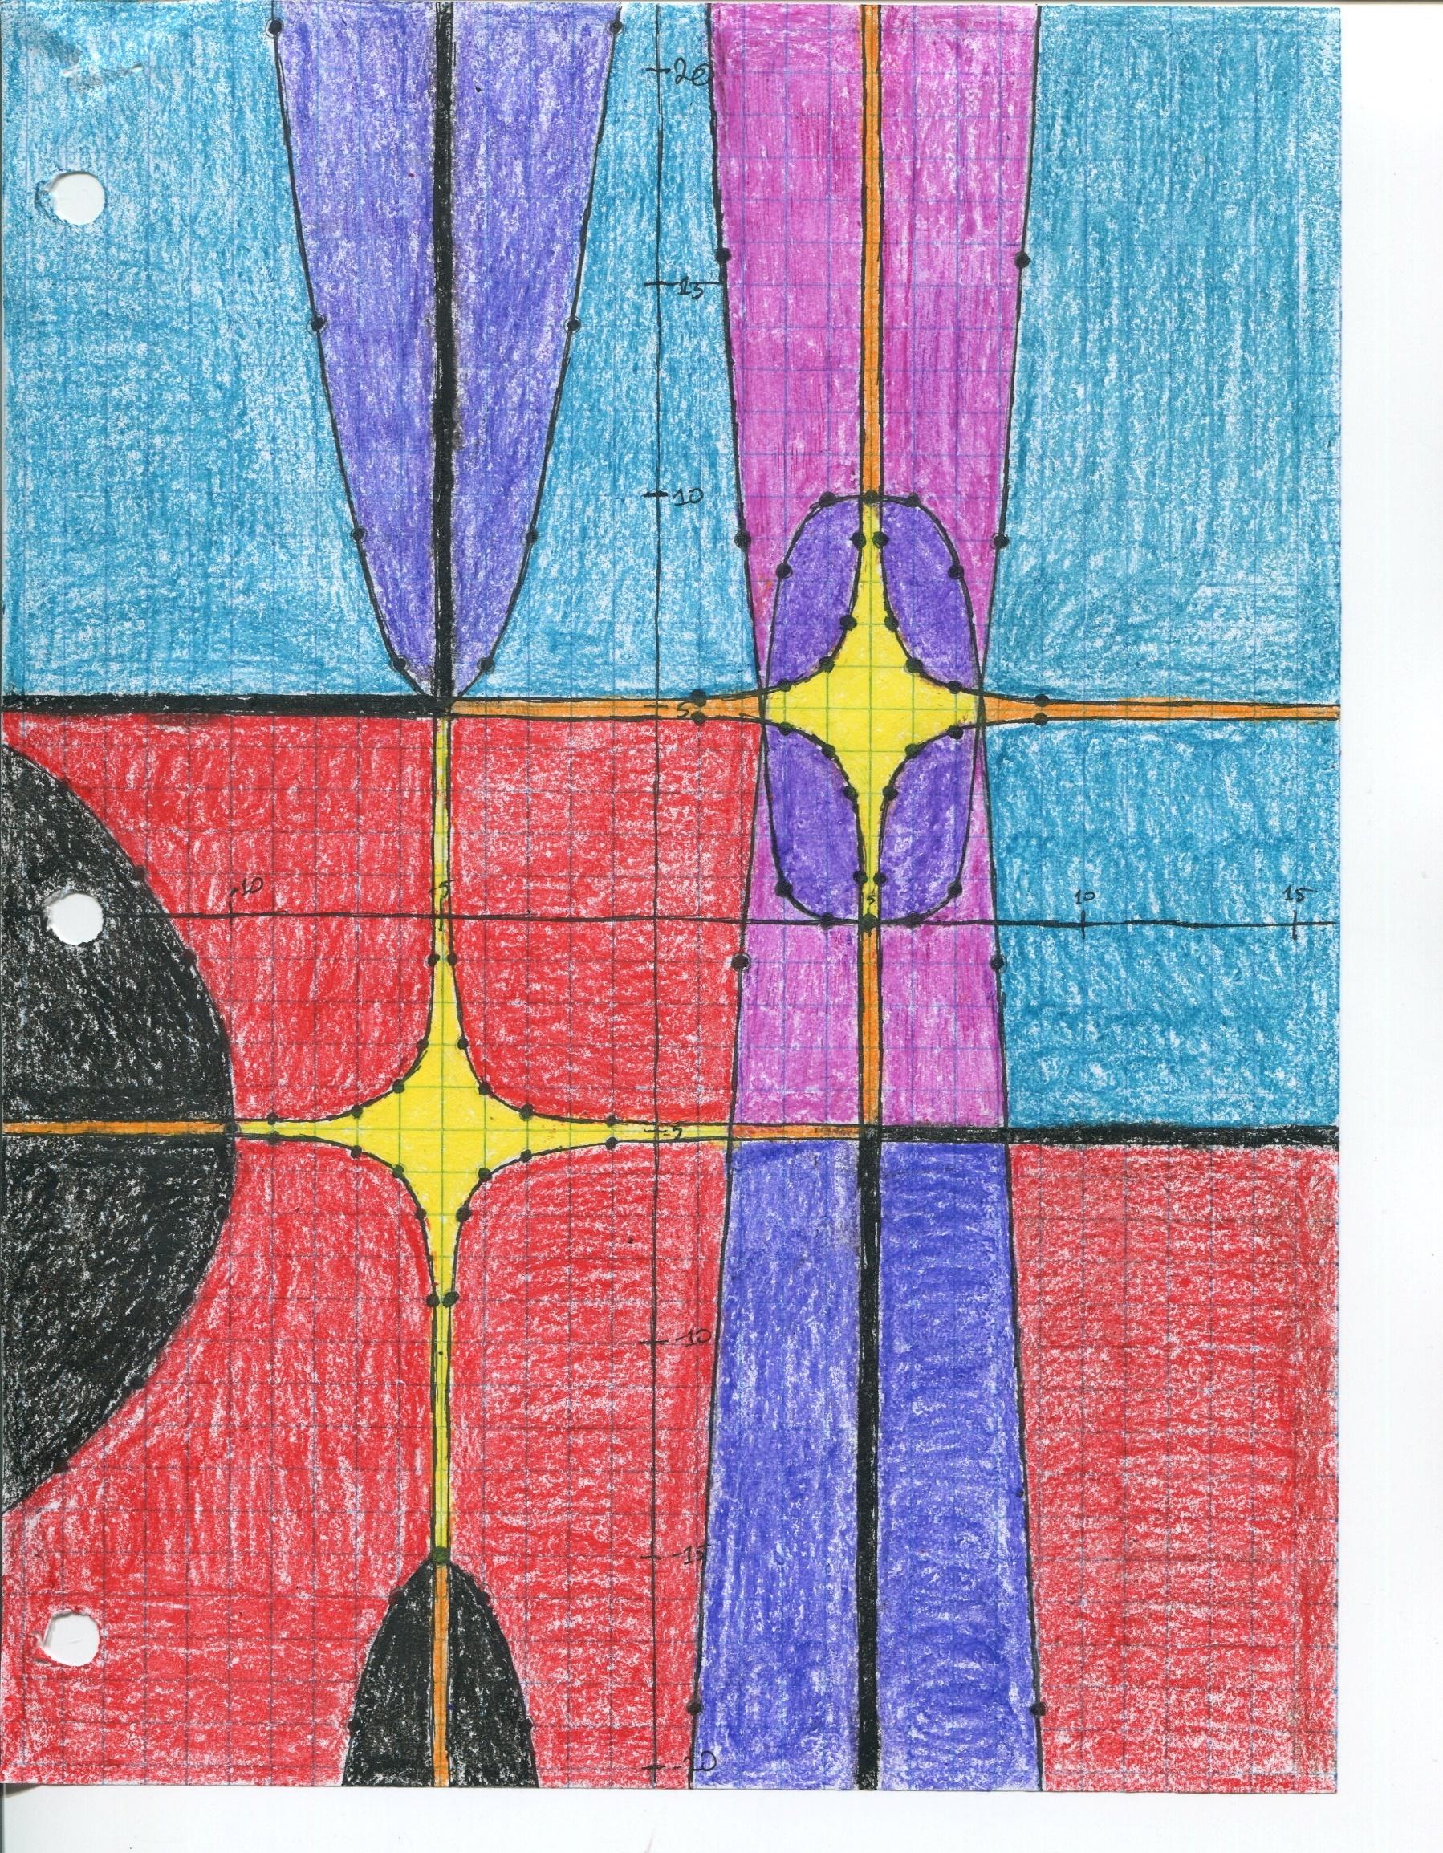
Examples
Exemplar –
MAT 126
Symmetry –
MAT 125
Non-symmetry –
MAT 125

Slide 25
Participation in Assessment Process

Slide 26
GEC Participation Overall
Semester | Full-time % | Part-time%
Fall 2021 | 69% | 25%
Spring 2022 | 66% | 24%
Fall 2022 | 60% | 22%
Spring 2023 | 90% | 21%

Slide 27
Canvas Outcomes participation
Semester | Full-time % | Part-time%
Fall 2021 | NA | NA
Spring 2022 | NA | NA
Fall 2022 | 32% | 9%
Spring 2023 | 80% | 11%
Notes:
We don’t have a breakdown by semester at all for 21-22. At that point, we had not yet implemented that process where instructors had to turn in a course level assessment each semester. That started Fall 2022.

Slide 28
Overall Results
Direct Results:
Faculty began identifying GECs with their nickname instead of number
Provided greater understanding of the process
More participation!
Indirect Results:
Helped simplify overall assessment process; focus on one GEC per semester
Created more opportunities for students to demonstrate GECs in the classroom

Slide 29
Questions?
Holly Norton, Vice President of Educational and Student Services
holly.norton@src.edu
Shelli Stuart, Math Faculty and Assessment Chair
shelli.stuart@src.edu
Lisa Dennis, Director of Academic Support
lisa.dennis@src.edu

